Slide 1
DATA QUALITY
ISSUES
Data quality and errors – Sources of error in GIS – Finding and modeling errors of GIS – Managing GIS error

Slide 2
Errors in source data for GIS
There are other cartographic difficulties, some of which affect other types of data as well as maps.
These include the representation of continuous data and features with indistinct (or fuzzy) boundaries.
Problems may also be introduced because of sampling and measurement difficulties.
Cartographic data sources error are:
  CONTINUOUS DATA
  FUZZY BOUNDARIES
  MAP SCALE
  MAP MEASUREMENTS

Slide 3
Errors in source data for GIS
CONTINUOUS DATA:
Continuous data require special cartographic representation.
For example, height is usually represented by contours on paper maps. Annotated lines indicate land of a particular height above a datum (usually sea level).
Limited additional information is provided by spot heights. Apart from this, no information is given about the height of the land between contours, except that it lies somewhere in the range denoted by the bounding contours. Since height varies continually over space, the vector-based contour and spot height model is always a compromise for the representation of height data.

Slide 4
Errors in source data for GIS
FUZZY BOUNDARIES
Where changes between entities are gradual in nature, such as between soil types, vegetation zones or rural and urban areas of settlement, indistinct boundaries exist.
These ‘fuzzy’ boundaries are difficult to represent cartographically. As a result, features are often made distinct by drawing sharp boundaries around entities.
This will ultimately lead to positional errors and attribute uncertainty in digital map data.

Slide 5
Errors in source data for GIS
MAP SCALE
Whether the ‘fuzziness’ of natural boundaries is important depends largely on the scale at which the data are mapped and viewed.
For instance, if a soil boundary is mapped at a large scale (for example 1:1250) then the representation of a fuzzy boundary can result in a significant amount of error.
However, if the boundary is mapped at a much smaller scale (such as 1:25,000) then the error resulting from the representation, although still there, is no longer so significant.

Slide 6
Errors in source data for GIS
MAP SCALE
The thickness of the line used to draw the boundary on the map at this scale may well account for much of the fuzziness between the soil types on the ground.

Slide 7
Errors in source data for GIS
MAP MEASUREMENTS
Measurements on maps and other data sources are rarely 100 per cent accurate.
Generalization aside, measurements such as contour heights, feature locations and distances have limited accuracy because of human and mechanical error.
Human measurement error can result from personal bias (for example, in the interpretation of aerial photographs), typographical errors, equipment reading errors and mistakes in the use of equipment.
Examples of machine error may include limitations of surveying equipment, limited accuracy of GPS receivers and equipment calibration errors.

Slide 8
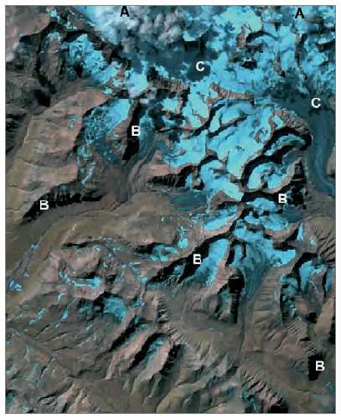
Errors in source data for GIS
Problems with remotely sensed imagery.
Satellite image with cloud cover (A);
Shadows from topography (B);
Shadows from cloud cover (C)

Slide 9
Errors in data encoding
Data encoding is the process by which data are transferred from some non-GIS source, such as the paper map, satellite image or survey, into a GIS format.
The method of data encoding, and the conditions under which it is carried out, are perhaps the greatest source of error in most GIS.
Digitizing, both manual and automatic, is an important method of data entry, so this section will focus on errors that can arise during digitizing.

Slide 10
Errors in data encoding
Despite the availability of hardware for automatic conversion of paper maps into digital form, much of the digitizing of paper maps is still done using a manual digitizing table.
Manual digitizing is recognized by researchers as one of the main sources of error in GIS (Otawa, 1987; Keefer et al., 1988; Dunn et al., 1990);
However, digitizing error is often largely ignored. Beyond simple checks in the editing process, practical means of handling digitizing errors do not exist in proprietary GIS software.

Slide 11
Errors in data encoding
Sources of error within the digitizing process are many, but may be broken down into two main types: source map error and operational error.
Operational errors are those introduced and propagated during the digitizing process.
Human operators can compound errors present in an original map (Poiker, 1982) and add their own distinctive error signature.
Some of the operational errors that can be introduced during manual digitizing are outlined.

Slide 12
Operational errors
Following the exact course of a line on a map with a digitizer cursor is a difficult task, requiring skill, patience and concentration.
Hand wobble, a tendency to under- or overshoot lines, strain and lack of hand–eye coordination are all sources of human error in the digitizing process.
Categorizes human digitizing error into two types:
  psychological and physiological.
To these can be added errors resulting from problems with line thickness and the method of digitizing which is used.

Slide 13
Operational errors
1 Psychological errors include difficulties in perceiving the true centre of the line being digitized and the inability to move the cursor cross-hairs accurately along it.
This type of error results in lateral offset between the true and digitized line and under- or overshoots at corners. Under- and overshoots and lateral displacement of features can be difficult to spot and correct.

Slide 14
Operational errors
2 Physiological errors result from involuntary muscle spasms (twitches and jerks) that give rise to random displacements or ‘spikes’ and polygonal knots or ‘switchbacks’ (Figure).
Some of these errors, such as spikes and knots, are easy to spot and correct.

Slide 15
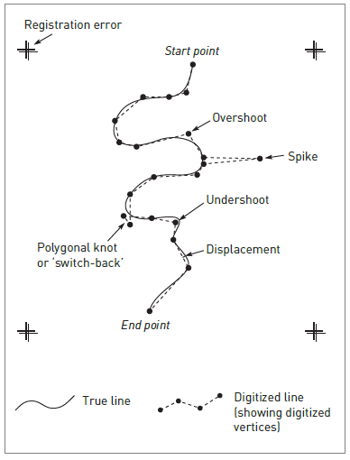
Operational errors

Slide 16
Operational errors
3 Line thickness. The thickness of lines on a map is determined by the cartographic generalization employed.
All lines are drawn so as to be visible to the user and thickness may in some instances reflect the perceived importance of the feature being depicted rather than its actual size on the ground.
A major road may be shown on a map by a line wider than the cross-hairs on the digitizer cursor.
Common sense suggests that the true course of the line is along its mid-point, but it is a difficult task for the operator to follow the centre of the line exactly.
Some displacement of the cursor either side of the centre line is inevitable, leading to positional errors in the resulting data.

Slide 17
Operational errors
4 Method of digitizing. There are two basic methods of manual digitizing: point mode and stream mode.
Point mode digitizing allows careful selection of sample points to create a faithful representation of a line.
This method involves a certain amount of generalization by the operator, who decides both the
number and location of sample points.
The greater the sample size, the greater the detail, but the positional error associated with each point remains much the same.

Slide 18
Operational errors
In stream mode digitizing, sampling is determined by the frequency set by the user at the start of the digitizing session.
The number of points sampled is controlled more by line complexity, since the operator can move relatively quickly along straight sections but needs to slow down significantly to navigate the cursor along more convoluted sections.

Slide 19
Operational errors
The errors occur during the digitizing process. However, errors can arise earlier.
For example, before starting to digitize, the map needs to be placed on the digitizing table and registered to enable later conversion from digitizer to geographic co-ordinates.
If this is done incorrectly or carelessly then the whole set of co-ordinates digitized during that session will contain the same error or bias.
Care when setting up the map document on the digitizer is therefore essential.

Slide 20
Operational errors
Automatic digitizing, like manual digitizing, requires correct registration of the map document before digitizing commences, but there the similarity ends.
By far the most common method of automatic digitizing is the use of a raster scanner.
This input device suffers from the same problems regarding resolution as the raster data model.
Cell size is important. The smaller the cell size, the greater the resolution of the resulting image and the greater the quantity of the data produced.

Slide 21
Operational errors
Cell size is determined by the resolution of the machine being used; a fine resolution may produce data with less positional error than manual digitizer output.
Data input by either manual or automatic digitizing will almost always require editing and cleaning. This is the next source of errors in GIS.

Slide 22
Errors in data editing and conversion
Editing geographic data is the process of creating, modifying, or deleting features and related data on layers in a map.
Data conversion is the process of moving data from one format into another, whether it is from one data model to another or from one data format to another.

Slide 23
Errors in data editing and conversion
After data encoding is complete, cleaning and editing are almost always required. These procedures are the last line of defence against errors before the data are used for analysis.
Of course, it is impossible to spot and remove all the errors, but many problems can be eliminated by careful scrutiny of the data.
As a potential source of error, cleaning and editing do not rank high; they are positive processes. Some GIS provide a suite of automated procedures, which can lead to unexpected results.

Slide 24
Errors in data editing and conversion
For example, it is common for vector GIS software to contain routines to check and build topology.
The closing of ‘open’ polygons and the removal of ‘dangling’ lines (over overshoots) are controlled by tolerances set by the user.
If the tolerances are set too low, then the gaps in polygons will not be closed and overshoots will not be removed. Alternatively, if the tolerances are set too high, small polygons may disappear altogether and large dangling lines, which may be required on networks, may also disappear (Figure).

Slide 25
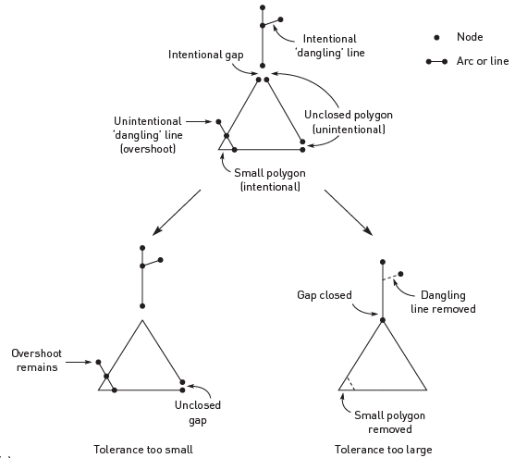
Topological errors in vector GIS
Effects of tolerances on topological cleaning

Slide 26
Errors in data editing and conversion
A different problem occurs when automated techniques are used to clean raster data. The main problem requiring attention is ‘noise’ – the misclassification of cells.
Noise can be easy to spot where it produces a regular pattern, such as striping.
At other times it may be more difficult to identify as it occurs as randomly scattered cells.
These noise errors can be rectified by filtering the raster data to reclassify single cells or small groups of cells by matching them with general trends in the data.

Slide 27
Errors in data editing and conversion
The ‘noisy’ cells are given the same value as their neighbouring cells.
Filtering methods for this process are discussed. Choosing an appropriate method is important as the wrong method may remove genuine variation in the data or retain too much of the noise.
After cleaning and editing data it may be necessary to convert the data from vector to raster or vice versa. During vector to raster conversion both the size of the raster and the method of rasterization used have important implications for positional error and, in some cases, attribute uncertainty.

Slide 28
Errors in data editing and conversion
The smaller the cell size, the greater the precision of the resulting data. Finer raster sizes can trace the path of a line more precisely and therefore help to reduce classification error – a form of attribute error.
Positional and attribute errors as a result of generalization are seen as classification error in cells along the vector polygon boundary.
This is seen visually as the ‘stepped’ appearance of the raster version when compared with the vector original (Figure).

Slide 29
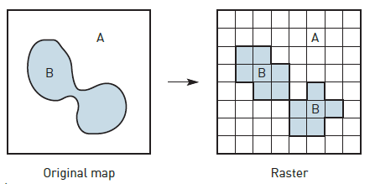
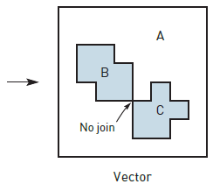
Topological ambiguities in raster to vector conversion

Slide 30
Errors in data editing and conversion
Provides further examples of errors created during the vector to raster conversion process. The results of this process are often more generalized data with more uncertainty attached.
The conversion of data from raster to vector format is largely a question of geometric conversion; however, certain topological ambiguities can occur – such as where differently coded raster cells join at corners as in Figure.

Slide 31
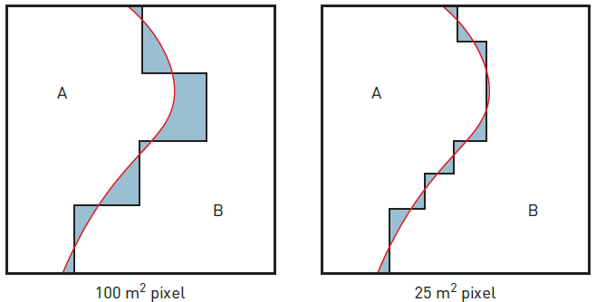
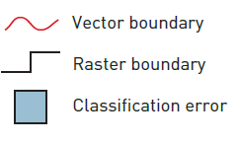
Vector to raster classification error

Slide 32
Errors in data editing and conversion
In this case it is impossible to say, without returning to the original source data, whether the vector polygons should join. Where vector maps have been derived from raster data, conversion may result in a stepped appearance on the output map.
This can be reduced, to some extent, by line-smoothing algorithms, but these make certain assumptions about topological relationships and detail that may not be present in the raster source data.

Slide 33
Rasterization errors
Vector to raster conversion can cause an interesting assortment of errors in the resulting data.
For example:
1 Topological errors. These include loss of connectivity, creation of false connectivity, loss of information, where individual vector polygons are smaller than the chosen raster cell size, and ambiguities due to changes in raster orientation and datum.
Connectivity problems occur when rasterizing vector polygons are separated by narrow gaps or connected via long narrow corridors. Significant features such as these are easily lost if they are narrower than an individual raster cell.

Slide 34
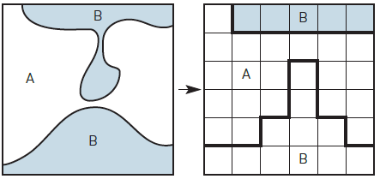
Loss of connectivity and creation of false connectivity

Slide 35
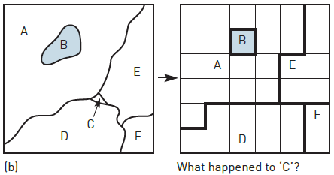
Loss of Information

Slide 36
Rasterization Errors
2 Loss of small polygons. When individual vector polygons are less than half the area of the raster cell or small enough to be missed by adjacent cell centroids, they may be lost in the conversion process.
3 Effects of grid orientation. If two identical grids are placed over the same vector map but at different angles (such that the difference between the angles is not a multiple of 90), the resulting raster maps will be different from each other.
It is usual when rasterizing vector data for the grid to be oriented parallel to the co-ordinate system of the source data.

Slide 37
Rasterization Errors
However, certain circumstances may dictate that a different orientation is required (such as when integrating rasterized vector data with satellite imagery where the satellite track is not parallel to the vector co-ordinate system or when using data digitized on a different projection system). This is illustrated in Figure.
4 Variations in grid origin and datum. Using the same grid but with slightly different origins (where the difference is not a multiple of raster size) will result in two different raster maps in much the same fashion as with grid orientation. This is illustrated in Figure.

Slide 38
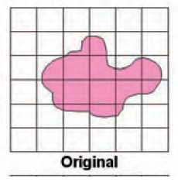
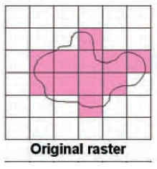
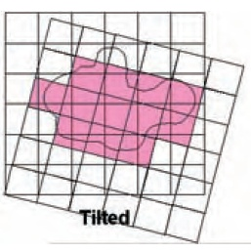
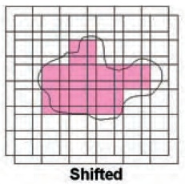
Effect of grid orientation
Effect of grid orientation and origin on rasterization

Slide 39
Rasterization Errors
Most GIS packages provide data conversion software so that their files can be read by other GIS.
For example, a GIS program may not be able to read data from a CAD package, so a conversion program is supplied to convert to another format, such as DXF, which both can handle.
Users naturally assume that these conversion routines work without introducing new errors into the data. However, the transfer of a GIS database from one software package to another can lead to errors through changes in format and definitions.
These database transfer errors are a kind of ‘mechanical’ error that is often overlooked. To overcome this problem standard formats have been developed such as those being promoted by the OpenGIS Consortium.

Slide 40
Errors in data processing and analysis
Errors may be introduced during the manipulation and analysis of the GIS database. GIS users must ask themselves questions before initiating a GIS analysis.
For example: Are the data suitable for this analysis? Are they in a suitable format? Are the data sets compatible?
Are the data relevant? Will the output mean anything? Is the proposed technique appropriate to the desired output?
These questions may seem obvious but there are many examples of inappropriate analysis.

Slide 41
Errors in data processing and analysis
These include the inappropriate phrasing of spatial queries, overlaying maps which have different co-ordinate systems, combining maps which have attributes measured in incompatible units, using maps together that have been derived from source data of widely different map scales and using an exact and abrupt method of interpolation (such as Thiessen polygons) to interpolate approximate and gradual point data (height data collected using GPS).
GIS operations that can introduce errors include the classification of data, aggregation or disaggregation of area data and the integration of data using overlay techniques.

Slide 42
Errors in data processing and analysis
The way in which we classify and reclassify data affects what we see and therefore how we interpret the data.
Choropleth mapping is an example. Much has been written in the cartographic literature on how the definition of class intervals in this sort of map can radically affect the pattern produced (Monmonier, 1996).
Take, for example, a choropleth map of unemployment by region drawn from census data. How the class intervals are defined can affect perception of unemployment across the country.

Slide 43
Errors in data processing and analysis
Similarly, how the areas are shaded also influences what we see in terms of pattern and magnitude. Dark colours in this instance can be used for the top two classes to create a more depressing feel.
Classification errors also affect raster data.
Classified satellite images provide a reflectance value for each pixel within a specific wavelength range or spectral band (for example, red, near infrared or microwave).
Raster maps of environmental variables, such as surface cover type, are derived by classifying each pixel in the image according to typical reflectance values for the range of individual cover types present in the image.

Slide 44
Errors in data processing and analysis
Error can occur where different land cover types have similar reflectance values (for example, asphalt car parks may have similar reflectance to mature spruce forest) and where shadows cast by terrain, trees or buildings reduce the reflectance value of the surface.
Careful choice of classification method can help to reduce this type of error.
Where a certain level of spatial resolution or a certain set of polygon boundaries are required, data sets that are not mapped with these may need to be aggregated or disaggregated to the required level.
This is not a problem if the data need to be aggregated from smaller areas into larger areas, provided that the smaller areas nest hierarchically into the larger areas.

Slide 45
Errors in data processing and analysis
Problems with error do occur, however, if we wish to disaggregate our data into smaller areas or aggregate into larger non-hierarchical units.
The information required to decide how the attribute data associated with the available units aggregates into the larger but non-nested units or disaggregates into a set of smaller units, rarely exists.
This problem is normally approached by assuming that the data in the source units are evenly distributed by area (for example, population within an enumeration district is evenly distributed across its total area).

Slide 46
Errors in data processing and analysis
The data for the new set of units or areas are in this case simply calculated as a function of the area of overlap with the source units.
However, such a homogeneous distribution of data within the source units cannot always be correctly assumed. In the case of population, distribution will depend on urban morphology, which can vary over small areas.
For example, even population distribution may be assumed across an area of similar housing type, but in an area of mixed land use (for example, housing, parkland and industrial estates) it cannot.
Aggregation, disaggregation and classification errors are all combined in the modifiable areal unit problem (MAUP).

Slide 47
Errors in data processing and analysis
Error arising from map overlay in GIS is a major concern and has correspondingly received much attention in the GIS literature (Chrisman, 1989; Goodchild and Gopal, 1989; Openshaw, 1989).
This is primarily because much of the analysis performed using GIS consists of the overlay of categorical maps (where the data are presented in a a series of categories).
GIS allows the quantitative treatment of these data (for example, surface interpolation or spatial autocorrelation), which may be inappropriate.
Map overlay in GIS uses positional information to construct new zones from input map layers using Boolean logic or cartographic modelling.

Slide 48
Errors in data processing and analysis
Consequently, positional and attribute errors present in the input map layers will be transferred to the output map, together with additional error introduced by multiplicatory effects and other internal sources.
Data output from a map overlay procedure are only as good as the worst data input to the process.
Perhaps the most visual effect of positional error in vector map overlay is the generation of sliver polygons. Slivers (or ‘weird’ polygons) occur when two maps containing common boundaries are overlaid.

Slide 49
Errors in data processing and analysis
If the common boundaries in the two separate maps have been digitized separately, the co-ordinates defining the boundaries may be slightly different as a result of digitizing error. When the maps are overlaid a series of small, thin polygons will be formed where the common boundaries overlap (Figure).
Slivers may also be produced when maps from two different scales are overlaid.
Of course, sliver polygons can and do occur by chance, but genuine sliver polygons are relatively easy to spot by their location along common boundaries and their physical arrangement as long thin polygonal chains.

Slide 50
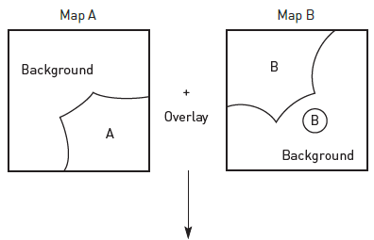
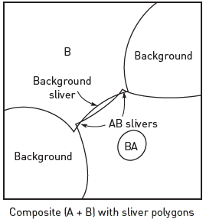
Generation of sliver polygons

Slide 51
Errors in data processing and analysis
Also shown in Figure is the attribute error that can result from positional error. If one of the two maps that are overlaid contains an error (such as the missing ‘hole’ feature in map A that is present as an island in map B), then a classification error will result in the composite map (polygon BA).
Chrisman (1989) identifies these two cases as extremes and points out that one type of error (positional or attribute) will inevitably result in the other type of error in the output map and vice versa.
Classification errors occur along the common boundary where the slivers are produced as a result of positional error and attribute error.

Slide 52
Errors in data output
From the preceding discussion it should be clear that all GIS databases will contain error. In addition, further errors will be introduced during manipulation and analysis of the data.
Therefore, it is inevitable that all GIS output, whether in the form of a paper map or a digital database, will contain inaccuracies. The extent of these inaccuracies will depend on the care and attention paid during the construction, manipulation and analysis of the databases.
It is also possible that errors can be introduced when preparing GIS output. For example, if we choose the map as a means of communicating the results of our analysis, it may be necessary to generalize data for the sake of clarity. This will add errors and assumptions into the database.

Slide 53
FINDING AND MODELLING ERRORS IN GIS
Much research effort has focused on identifying, tracking and reducing error in GIS. One American GIS research organization, the National Center for Geographic Information and Analysis, even placed the problem of error in GIS first on its list of research priorities (NCGIA, 1989).
Despite this research effort, little has been done to incorporate error identification, modelling and handling techniques within proprietary GIS packages.
This has had the effect of keeping awareness of the general error problem at a low level amongst non-specialist GIS users.
However, there are methods for detecting and modelling errors that users can employ to improve confidence in their data and results.
Methods for checking data include visual inspection, double digitizing, the examination of error signatures and statistical analysis.

Slide 54
Checking for errors
Probably the simplest means of checking for data errors is by visual inspection. This should be included as a matter of course in the data cleaning and editing process.
Once in a GIS format, data can be plotted on paper or on the graphics screen for visual comparison with the original source document.
Obvious oversights in the digitizing process and missing data will be revealed and can be amended. The attributes of spatial features can be checked by adding annotations, line colours and patterns.
Again, comparison with the original map should reveal major errors.

Slide 55
Checking for errors
Double digitizing is an error-checking method used by large digitizing operations (for example map producers such as the UK Ordnance Survey).
The same map is digitized twice (possibly by different people) and the resulting copies compared to identify inconsistencies.
Polygon areas, length of lines, polygon perimeters and the number of sliver polygons produced are calculated and compared.
If the two versions are deemed significantly dissimilar, then the map may be re-digitized and the comparison repeated. However, this is a costly and time-consuming method of error checking.

Slide 56
Checking for errors
Work on the psychological and physiological aspects of digitizing (Box 10.5) suggests that each operator has a different error signature that describes how they digitize.
An operator may, for example, consistently over- or undershoot changes in line direction or show lateral displacement relative to position on the digitizing table.
If different digitizer operators do have recognizable and repeatable error signatures, these could be used to effectively cancel out the errors introduced in digitizing.

Slide 57
Checking for errors
Various statistical methods can be employed to help pinpoint potential errors.
Attribute errors in GIS data sets may stand out as extreme data points in the distribution of data values; or outliers in scatter plots if plotted against a correlated variable (for example, total annual rainfall against number of rain days).
A statistical measure of the error attributed to generalization and line thickness can be gained by estimating the total area of the map covered by lines.
An example given by Burrough (1986) shows that a 1:25,000 scale soil map measuring 400 × 600 mm may have as much as 24,000 mm of drawn lines, covering 10 per cent of the map’s total area.

Slide 58
Error modelling
There are relatively few tried and tested approaches to modelling of errors in spatial data and these tend to focus on the effects of quantifiable positional errors.
Two such methods are:
Epsilon modelling and
Monte Carlo simulation.
Epsilon modelling is based on an old method of line generalization developed by Perkal (1956). Blakemore (1984) adapted this idea by using the model to define an error band about a digitized line that described the probable distribution of digitizing error about the true line.

Slide 59
Error modelling
The shape of a graph of the error distribution is a matter of debate, but the graph is probably a bell-shaped curve.
A true normal distribution is unlikely since very large errors represented by the tails of the distribution are rare and easily spotted and removed in the data cleaning and editing process.
Some authors believe a ‘piecewise quartic distribution’ to be most realistic. This has a flatter central peak and tails that quickly run out to zero (Brunsdon et al., 1990).
Others have suggested a bimodal distribution on the grounds that digitized points are very unlikely to fall exactly on the line.

Slide 60
Error modelling
In an empirical example based on overlaying employment offices (points) with employment office areas (polygons), Blakemore (1984) found that he could unambiguously assign only 60 per cent of the points to any polygon.
The remaining 40 per cent were found to lie within the specified epsilon band width for the employment office area polygons.
From this work Blakemore defined the five different categories of containment illustrated in Figure.

Slide 61
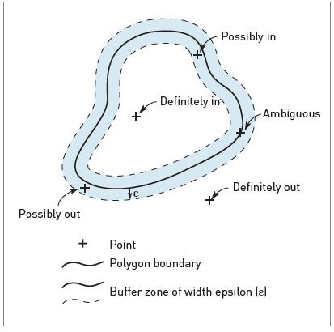
Error modelling
Point-in-polygon categories of
containment

Slide 62
Error modelling
The epsilon model has been developed in various ways and with various error distributions to produce a seemingly robust means of error modelling.
Given information on the distribution of error in the input data layers, this technique can be used to handle error in GIS operations by allowing for the epsilon band in GIS analyses to improve the confidence of the user in the results (Carver, 1991a).
A Monte Carlo simulation approach has also been used to model the effects of error in GIS overlays (Fisher, 1991; Openshaw et al., 1991).

Slide 63
Error modelling
This method simulates the effect of input data error by the addition of random ‘noise’ to the line co-ordinates in map data and as such is a kind of ‘jack-knifing’ (a technique often used in the statistical analysis of error and uncertainty based on re-sampling data based on random models).
Each input data source is assumed to be characterized by an error model that represents reasonable estimates of positional error thought to be present in a similar manner to the epsilon approach.
The random ‘noise’ added to the map co-ordinates simulates the combined effects of source map and digitizing errors by slightly varying the course of the original shape of the line.

Slide 64
Error modelling
The randomized data are then processed through the required series of GIS operations and the results saved. This entire process is repeated many times. If the output is numeric, then the distribution of the results gives some indication of the effects of input data error.
If the output is in the form of a map, then the total set of saved maps can be used to draw confidence intervals. A simple example would be described how results from the D8 algorthm are more uncertain in areas of lower relief. This is illustrated where the effects of uncertainty in the DEM and D8 algorithm have been simulated using a Monte Carlo simulation approach.

Slide 65
Error modelling
Note: how the uncertainty envelopes are much wider in the lower relief areas where adding random noise to the DEM has greatest effect.
Fisher (1993 and 1994) describes how visibility analyses are susceptible to errors in digital elevation models.
He uses a Monte Carlo simulation approach to investigate uncertainty in the results that are caused by errors in the DEM and algorithms used.
Because many of the angles of lines of sight are so acute, even very small errors in the height values within the DEM can produce comparatively large errors in the visible area polygons.

Slide 66
Error modelling
In Happy Valley line of sight is important for ski rangers out on patrol because the range of their radios is significantly affected by the steep terrain.
Although reception can be maintained in the shadow of valleys and peaks as the radio signals are diffracted around and bounced off the mountains, the best reception is always maintained when there are no intervening hills or mountains between receivers and the base station.
Example for selected radio ‘viewpoints’ located in the mixed terrain of the Happy Valley ski resort and its surrounding area.
A Monte Carlo simulation is used to describe the certainty of the predicted radio coverage for each location. Note how uncertainty in the DEM used has the greatest effect in areas of relatively flat relief.

Slide 67
Error modelling
In both these examples, the results of these simulations can be overlaid on the normal, unvaried results as a visual means of communicating the likely effects of input data error.
The main drawback with this method is the large number of simulations required to achieve a statistically valid result.
For GIS processes where the effects of error need to be estimated, up to 100 extra sets of processing may be required.
Monte Carlo simulation is only likely to be used for very important analyses requiring a high level of confidence in the results.

Slide 68
Error modelling
Although initial research on Monte Carlo simulation focused on its use for modelling positional error in vector map overlay (Openshaw et al., 1991), the approach is equally applicable to modelling attribute or positional error in raster or vector GIS operations.
Another example of the use of Monte Carlo simulation modelling to prepare multiple surfaces representing uncertainty in terrain data.

Slide 69
Error modelling
Monte Carlo simulation could also be applied to the modelling of avalanche risk zones.
Because the models used are by no means perfect and there are known levels of error in the data used, and because the implications of making mistakes in the drawing up of ‘avalanche safe’ zones that are suitable for constructing ski pistes, hotels and other developments, the Happy Valley GIS team need to be absolutely certain that they are confident in their model results.
The higher overheads involved in running the avalanche model 100 times within a Monte Carlo simulation are in this case easily outweighed by the potential costs to life and property should the wrong decisions be made.

Slide 70
Error modelling
In combinatory models such as sieve mapping, the sensitivity of the resulting map to various input layers can be investigated using a technique known as ‘bootstrapping’.
This is a kind of leave-one-out analysis applicable to overlay analyses where the analysis is repeated n times, where n is the number of input data layers, leaving one of the input layers out of the analysis on each successive model run.
The results of the n analyses can be compared to identify their sensitivity to each of the input layers.
For example, in sieve mapping analysis, the number of times a polygon or cell appears in the final decision set is indicative of its robustness as a suitable location.

Slide 71
MANAGING GIS ERROR
To manage these errors we must track and document them.
The data quality parameters discussed earlier in this chapter – accuracy, precision, resolution, generalization, applicability, bias, compatibility, completeness and consistency – provide a useful checklist of quality indicators.
Documenting these for each data layer in a GIS, and for any new layers produced by analysis, will help subsequent users of the GIS to keep track of data quality. Data quality information is frequently used to help construct a data lineage.

Slide 72
MANAGING GIS ERROR
Lineage is a record of data history that presents essential information about the development of data from their source to their present format.
Lineage information should provide the data user with details of their source, method of data capture, data model, stages of transformation, editing and manipulation, known errors and software and hardware used.
In a way, lineage is like the service history in our car example. A good knowledge of lineage gives the user a better feel for the data and is indicative of its overall quality.

Slide 73
MANAGING GIS ERROR
Above all (as in the car’s service history) it lets the user know where problems with the data are likely to occur.
Unfortunately, just as with our car example, full service histories are something of a rarity in GIS.
Depending on the context, documentary evidence may be available.
Some digital data suppliers provide good lineage information in their accompanying materials.
Users are less likely to maintain good lineage records. They are not helped by the fact that few GIS packages provide any means of storing lineage information.

Slide 74
MANAGING GIS ERROR
A number of organizations involved in the creation, processing and use of digital map data have attempted formalization of lineage requirements.
Both the Association for Geographical Information (AGI) in the UK and the National Committee on Digital Cartographic Data Standards (NCDCDS) in the USA define basic lineage requirements such as:
Description of source data.
Transformation documentation.
Input/output specifications.
Application-dependent information.

Slide 75
Basic lineage requirements
1 Description of source data. This should contain information relevant to the data source, including its name, date and method of production, date of last modification, producer, reference, map scale and projection.
It should also include the necessary backward links so that the user can see how the source data were generated.
2 Transformation documentation. Transformation information contains details of the operations and actions that have led to the production of the data in their present form. This includes the commands, parameters and context of use.

Slide 76
Basic lineage requirements
3 Input/output specifications. This records details of the data files used and the products generated.
This information should include descriptions of file formats, transfer formats, input/output procedures, media specifications and any interaction the user makes with the process.
4 Application-dependent information.This category has been proposed to record information about the purpose for which a particular data set was generated.
This can help the user determine for which applications the data are useful.

Slide 77
MANAGING GIS ERROR
Lineage information can be recorded manually or automatically. The user may manually create the lineage by recording the information needed directly on paper or in a computer text file.
A paper based scheme involves the user keeping a record in a log book or card system as operations are carried out on the data.
Wholly computerized systems of manually recording lineage are perhaps the best option.
This is possible if a database system into which the user records lineage information runs concurrently with the GIS.

Slide 78
MANAGING GIS ERROR
Automatic systems remove the need for user input altogether. These are rare in GIS, but some GIS do produce log files automatically which can then be converted to lineage information when combined with data-specific information.

Slide 79
Benefits of lineage in quality control
Error detection: Lineage helps recreate analysis processes in which previous data sets containing errors have been used
Management accountability: Lineage provides information from which accounting can be undertaken (Aronoff, 1989). It allows the assessment of workloads and efficiency
External accountability: Lineage records the work of each GIS user, which allows others to assess the validity of the work undertaken
Quality reporting: The AGI in the UK and the NCDCDS in the USA define lineage as a requirement for GIS data quality reports. These should include information on data history, positional accuracy, attribute accuracy, completeness and logical consistency

